Slide 1

Marketing campaing analysis
FILIPE CHAVES DE MACEDO

Slide 2
INTRODUCTION
With the objective of helping the marketing department to spend its annual budget in a more assertive way, we made a brief case study based on past campaigns, where we want to know the customers and also some insights that may be useful.
Main topics on the next slides:
Past campaigns overview;
Customer’s profile;
Customer segmentation – RFM;
Customer segmentation – Kmeans;
Predictive model to improve de campaign’s profit.

Slide 3
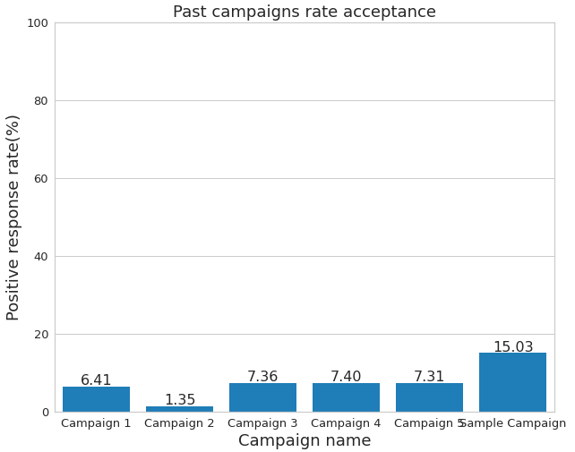
PAST Campaigns ANALYSIS
Below we can see the graph that shows the rate of positive responses in each campaign already carried out, 2240 responses were analyzed and the campaign with the highest sales conversion rate was the Sample Campaign with a percentage of 15,03%, with this data we can visualize that the effectiveness of the campaigns has been extremely low.
ATTENTION POINT:
In the sample campaign the marketing department spent 6.720MU and the revenue generated was 3.674MU, globaly the campaign had a profit of -3.046MU.

Slide 4
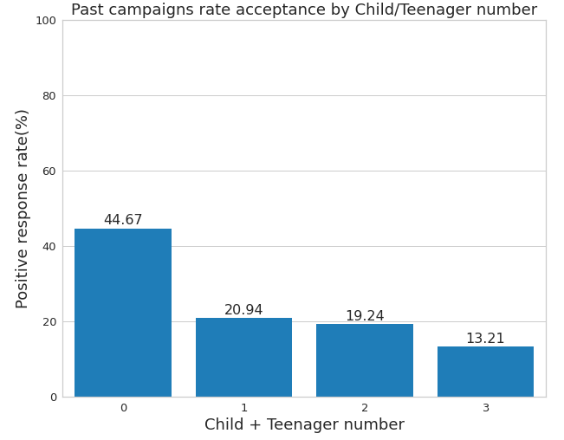
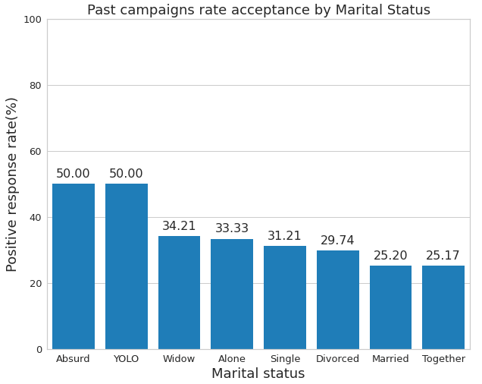
CUSTOMER’S PROFILE
Trying to better understand the profile of consumers, who accepted at least one offer in past campaigns, we analyzed the percentage of positive responses taking into account some characteristics that we will see below.
An interesting feature that can be seen with this analysis is that customers who do not have children or teenagers at home accepted offers from past campaigns in a greater proportion when compared to people who have one or more children or teenagers at home. Which is probably connected with the higher acceptance rate of people living without a partner.

Slide 5
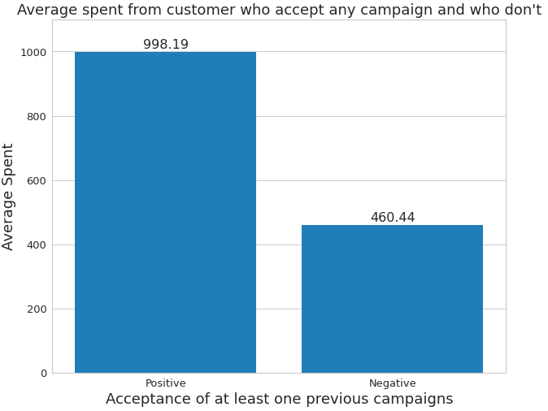
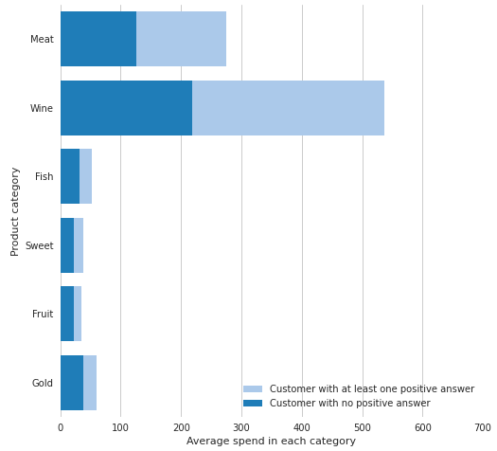
CUSTOMER’S PROFILE
We can see that our customers who have accepted offers from previous campaigns, on average spend more money on our products when compared to customers who have not. A large part of this spending is located in meat and wine products where customers who accepted a campaign spend on average twice as much when compared to customers who did not accept any campaign.

Slide 6
CUSTOMER SEGMENTATION - RFM
In customer segmentation, one of the used methods was the RFM (Recency, Frequency, Monetary) which is based on how recently, how often and how much a customer has purchased, from these three variables the customer receives a score that will define which group he will be allocated to. Where 3 is the score of the best customers group who have purchased more recently, spent more on purchases and bought more often, and 12 the score of the worst customers group who spend less, less frequently and have not purchased for the longest time.
Example:
Customer ID | Recency | Frequency | Amount spent | Recency score | Frequency score | Monetary score | RFM score
4141 | 26 | 20 | 776 | 2 | 1 | 2 | 5
6182 | 26 | 6 | 53 | 2 | 4 | 4 | 10
5324 | 94 | 14 | 422 | 4 | 2 | 2 | 8

Slide 7
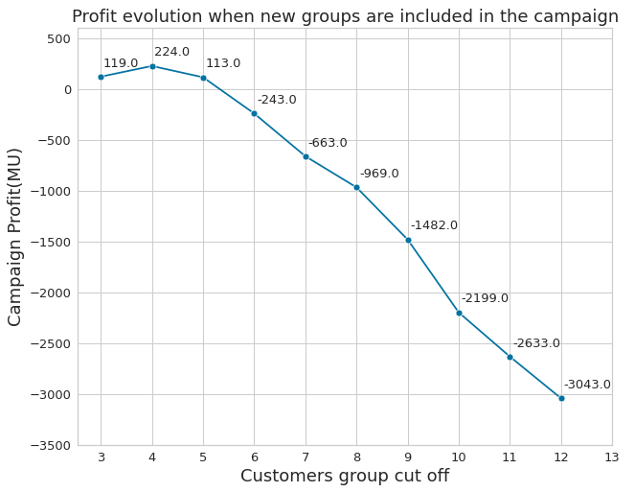
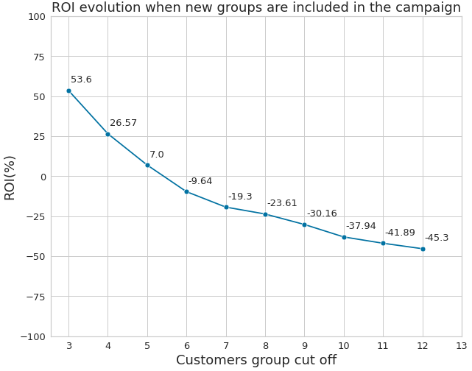
CUSTOMER SEGMENTATION - RFM
With the RFM segmentation were created ten customer groups, from the best(group 3) to the worse(group 12) we included group by group in the campaign analyzing the impact in two main factors the Profit and the ROI. Bellow we can see the results.
We can see that if we include just the groups with scores 3 and 4 in the campaign we can reach our best profit in 224MU.
The best ROI of 53,6% is when we have just the customers with score 3 being contacted, this occurs because this group has the best buying per contact rate.

Slide 8
CUSTOMER SEGMENTATION - RFM
Bellow we can see the table with all the data including campaign costs, sold gadgets and revenue.
RFM Score | Customers in the group | Contacted customers | Campaign cost (MU) | Sold gadgets | Campaign revenue (MU) | Group Profit | Profit (MU) | ROI(%)
3 | 74 | 74 | 222 | 31 | 341 | 119 | 119 | 53,6
4 | 207 | 281 | 843 | 97 | 1067 | 105 | 224 | 26,57
5 | 257 | 538 | 1614 | 157 | 1727 | -111 | 113 | 7
6 | 302 | 840 | 2520 | 207 | 2277 | -356 | -243 | -9,64
7 | 305 | 1145 | 3435 | 252 | 2772 | -420 | -663 | -19,3
8 | 223 | 1368 | 1404 | 285 | 3135 | -306 | -969 | -23,61
9 | 270 | 1638 | 4914 | 312 | 3432 | -513 | -1482 | -30,16
10 | 294 | 1932 | 5796 | 327 | 3597 | -717 | -2199 | -37,94
11 | 163 | 2095 | 6285 | 332 | 3652 | -434 | -2633 | -41,89
12 | 144 | 2239 | 6717 | 334 | 3674 | -410 | -3043 | -45,3

Slide 9
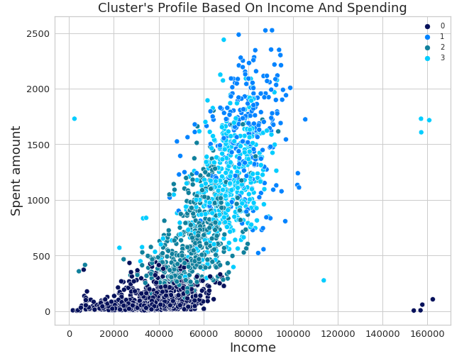
CUSTOMER SEGMENTATION - KMEANS
Another method we used to segment customers was Kmeans, which is able to assess the proximity of respondent’s characteristics and group them based on that. According to the method used, the best number of groups to segment customers is four.
Group number | Customers in the group | Campaign cost (MU) | Sold gadgets | Campaign revenue (MU) | Profit (MU) | ROI(%)
0 | 1006 | 3018 | 85 | 935 | -2083 | -69,02
1 | 260 | 780 | 133 | 1463 | 683 | 87,56
2 | 518 | 1554 | 71 | 781 | -773 | -49,74
3 | 455 | 1365 | 45 | 495 | -870 | -63,74
We can see that among the four groups, only one had a positive return of 683MU, where 260 customers were contacted and 133 gadgets were sold. If the campaign was made only with users in this group, the ROI would be 87.56%. Analyzing the characteristics of this group we have an idea of what makes it different from the others this group has higher medians in income, total spend, number of purchases and positive responses in previous marketing campaigns. We noticed that most of the clients in the group don't have children or teenagers at home

